Slide 1
Mobile devices in education
Eglė Vaivadienė, Lithuania, eglevaivadiene@gmail.com
21 February, 2018
Sesimbra, Portugal

Slide 2
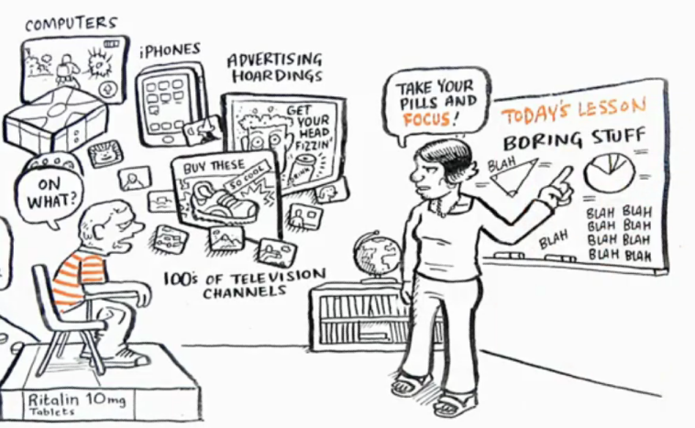
Our children are living in the most intensely stimulating period in the history of the earth!
Sir Ken Robinson – Changing Education Paradigms
http://technologyinthel2classroom.blogspot.com/2012/09/did-you-know.html
http://teachdifference.wordpress.com/

Slide 3
t
Blooms
Taxonomy

Slide 4
Digital Technologies in Education?
Find something that works
Learn how to use it
Apply it to your teaching

Slide 5
Things happening in Education
Bring Your Own Technology

Slide 6
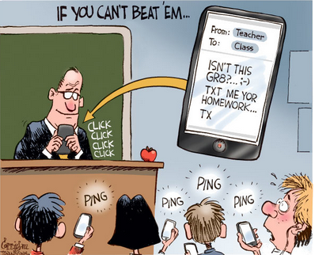
Mobile devices in education
Top 10 Reasons to Use Technology in Education: iPad, Tablet, Computer, Listening Centers: https://www.youtube.com/watch?v=mzi2RIt8_nk (5:30)
Podagogy: iPod Touch as 1:1 for education: https://www.youtube.com/watch?v=tApU_pKCl_8 (4:24)
http://www.securedgenetworks.com/secure-edge-networks-blog/?Tag=mobiletechnology
7 Techniques For Using iPads In The Classroom: http://www.securedgenetworks.com/secure-edge-networks-blog/

Slide 7
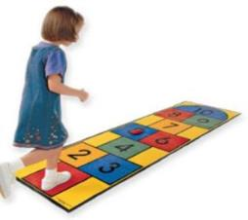
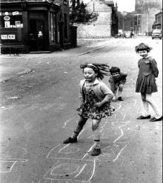
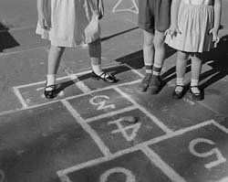
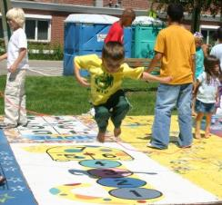
Which picture shows
most learning?
A)
B)
C)
D)
WWW.PLICKERS.COM

Slide 8
Games Based Learning

Slide 9
“Computer games are the most powerful learning technology of our age”
Henry Jenkins - MIT
Using Gaming Principles to Engage Students

Slide 10
Games Based Learning
3 great reasons to use games:
They can make people behave better
Learners just simply perform better
Players work harder voluntarily
Getting the Facts on Game Based Learning (INFOGRAPHIC)

Slide 11
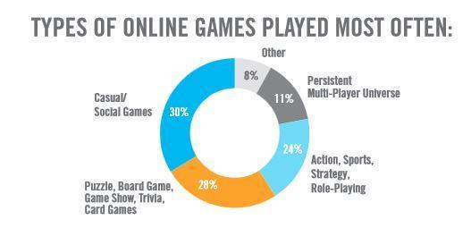
Types of Games
Simulations
Authentic learning games
Microworlds
Students created media
Role playing games
Inquiry- based learning games
Virtual 3D worlds (i.e. Second Life)
Strategy games (i.e. The Sims)
http://awokdotcom.tumblr.com/post/125343652757/types-of-online-games-most-often

Slide 12
ICT tools for assessment of student achievements

Slide 13
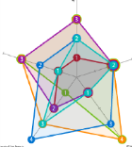
Plickers
Kahoot!
Quizziz
Quizlet Live
Quizalize video
Nearpod
Google drive
Voratinklis
ClassDojo
Socrative
Edmodo
Formative
TEDEd

Slide 14
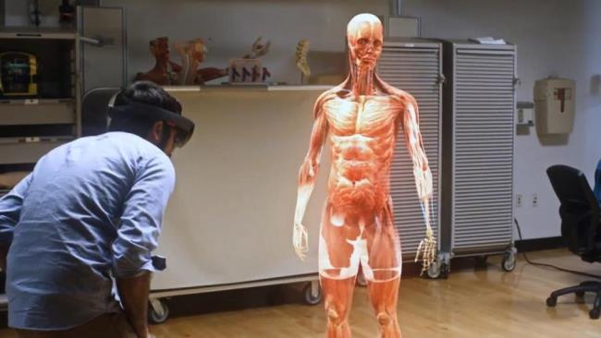
Examples. Virtual reality. 3D, 4D DLO
https://www.vrs.org.uk/category/virtual-reality-education/

Slide 15
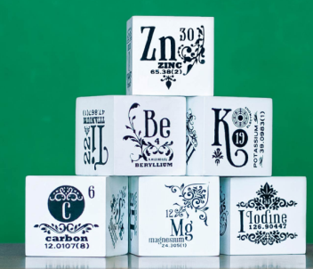
Elements 4D
An immersive, inspiring & interactive learning experience
http://elements4d.daqri.com/

Slide 16
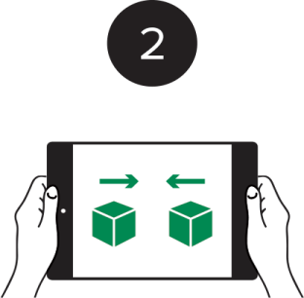
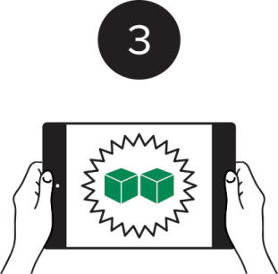
How it works Each block face depicts a different chemical symbol, representing the elements of the Periodic Table.
See the Elements in 4D
Open the Elements 4D App and point your device at the block face illustrating the element you want to view.
Combine Two Elements
Next, introduce a second element. Move the two blocks together until they touch.
Marvel at the Reaction You’ve Created!
If nothing happens, those elements don’t combine. Try another combination.

Slide 17
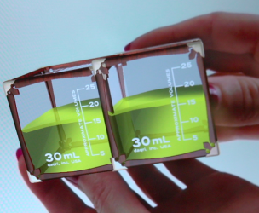
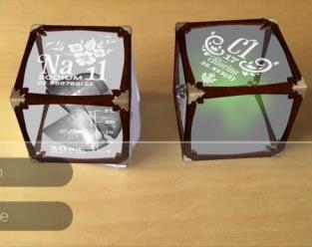
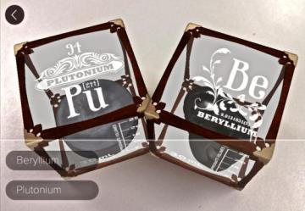
Elements 4D Educational Materials
Explore 4D in your classroom with inspiring and useful chemistry lesson plans, crafted by a group of talented teachers.
Work Elements 4D into your curriculum today.
Elementary School Middle School High School

Slide 18
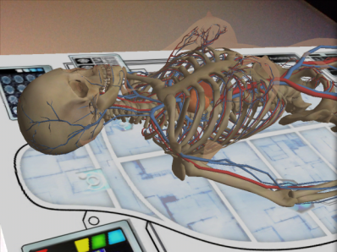
Anatomy 4D
How to Use Anatomy 4D?
To get started, print any of the images from the “Target Library” inside the app, accessible from the Main Menu.
Once printed, place the image on any flat surface, scan the image with your device and watch your 4D Experience come to life.

Slide 19
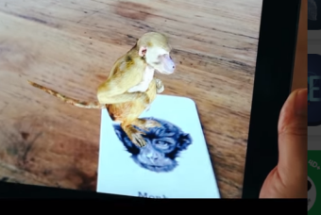
Animal 4D+
Multi languages: English, Spanish, Turkish, Japanese, Bahasa, Deutsch, Mandarin, Korean, French
- Holographic Mode
- Interactive Quiz
- Voice over
- Performance Optimization
(The features above will be available through in-app purchase or serial number registration)

Slide 20
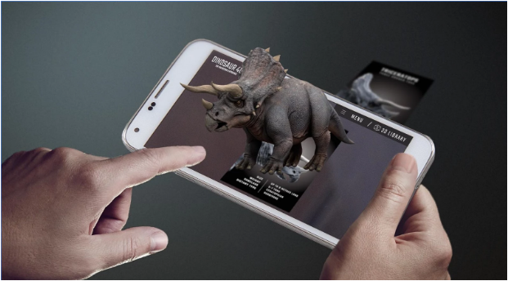
Dinosaur 4D+
Dinosaurs 4D+ gives you the prehistoric experience of unleashing extinct Dinosaurs which dwelt millions of years ago on Earth right before your very eyes! Pair the App with Dinosaurs 4D+ flashcards and watch as the 3D Dinosaurs leap out from the flashcards in Augmented Reality.
Video

Slide 21
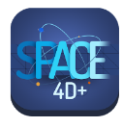
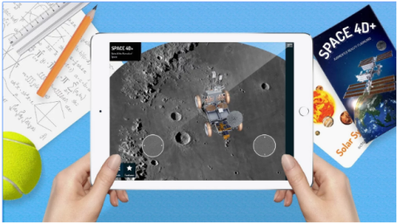
Space 4D+
pace 4D+ gives you both interesting and informative facts in AR mode about space such as Solar System, Planets, Space objects, Satellites, Rovers, Space Missions Etc.
The Space 4D+ app brings you a new way of seeing space in Augmented Reality. Video

Slide 22
PicQuick AR VR 3D
The Quiver App combines physical coloring from “back in the day” with state of the art augmented reality technology to bring you and your children an extraordinarily magical experience.
Quiver - 3D Coloring App

Slide 23
http://mattlieto.com/kids-coloring-books/free-coloring-apps-quiver-3d-coloring-app-coloring-sheets/
http://www.quivervision.com/coloring-packs/
STEAM resources: https://www.scoop.it/t/science-tech-engineering-arts-math

Slide 24
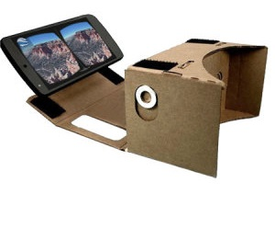
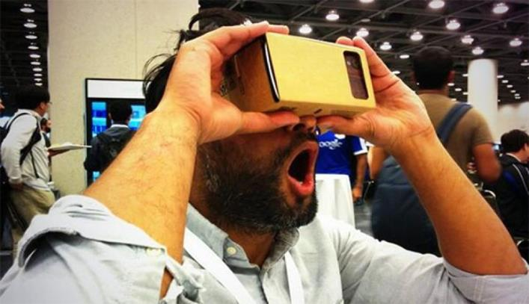
Google cardboard
Got Cardboard? Visit new places,
play immersive games,
fly through space
and more.
Immersive experiences for everyone

Slide 25
StarTracker VR - Mobile Sky Map
Description
It's the mobile planetarium in VR, designed for astronomy fans to explore the universe.
StarTracker VR introduce a brand new VR methodology to the VR world.

Slide 26
InMind VR
Description
InMind is a short adventure with arcade elements designed for the Windows Phone based VR. You are able to play with Cardboard viewer or without it (just tap and hold to switch modes). How to start video: http://bit.do/inmind
This first demo allows the player to experience the journey into the patient's brains in search of the neurons that cause mental disorder. Submerge into the microworld and experience the miracles of the human mind.

Slide 27
Roller Coaster VR
Description
Take a brake from pressure and stress by Riding on Roller Coaster in beautiful theme park near bank of river. This simulation is available in Virtual Reality as well as Simple Mode.
VR Crazy Roller Coaster Simulator is free Windows game in which you can enjoy ride on Roller Coaster. Realize yourself in a Train that is running on a Rolling track. Sometime you may even scare because you will really feel like a Roller Coaster Slide, Sharp turns and Slopes. You will also realize beautiful view of city from height.

Slide 28
Aquarium VR
Description
This interactive aquarium features sharks, clown fish and many more. Look deeper to learn more about the ethereal sea life in the pacific ocean.
To discover what type of fish are in our virtual reality aquarium, gaze at the specific fish to reveal their description.

Slide 29
Exspedition
Description
Google Expeditions is a virtual reality teaching tool that lets you lead or join immersive virtual trips all over the world — get up close with historical landmarks, dive underwater with sharks, even visit outer space!
Built for the classroom and small group use, Google Expeditions allows a teacher acting as a “guide” to lead classroom-sized groups of “explorers” through collections of 360° and 3D images while pointing out interesting sights along the way.

Slide 30
More than apps, experiences
Whether you want to float on a lazy river, play pong in space, or stand on stage with a legend, Cardboard has hundreds of immersive experiences to choose from.
GOOGLE PLAY STORE
How to make your own Google Cardboard headset

Slide 31
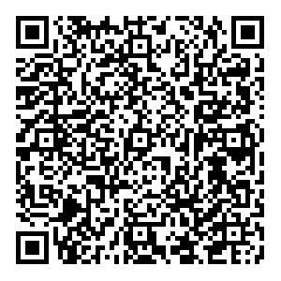
And more... Create QR Code
Create QR Code: http://createqrcode.appspot.com/
Read QR Code: ScanLife

Slide 32
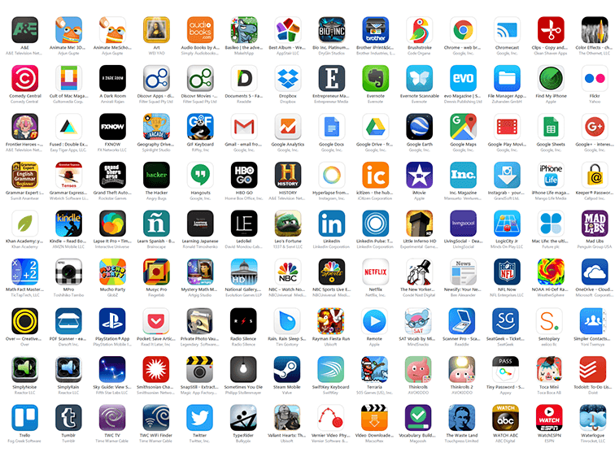
Top
10 best education apps for Android
The 25 Best Educational Apps for iPhone and Android
50 Of The Best Teaching & Learning Apps For 2016

Slide 33
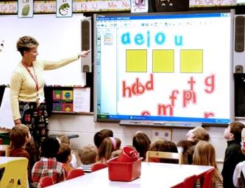
The task:
Find the app (VR / augmented reality / 3D or 4D
Try it out
Present the app features to the colleagues

Slide 34
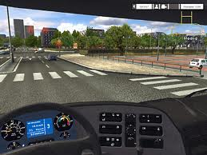
Educational Simulations
Educational simulations use rigorously structured scenarios with highly refined set of rules, challenges, and strategies which are carefully designed to develop specific competencies that can be directly transferred into the real world.
i.e Driving Simulation Games

Slide 35
More ...
https://www.grammarly.com/
Grammarly lets you check for 250 types of grammatical, spelling, and punctuation mistakes – as well as for plagiarism
Website www.grammarly.com
The Hemingway App makes your writing bold and clear.
Website www.hemingwayapp.com

Slide 36
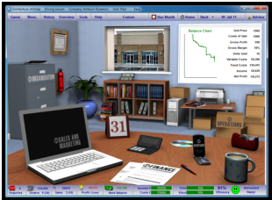
Role playing
SimVenture: allows players to setup and run their own virtual company and learn about business and being an entrepreneur
www.simventure.co.uk

Slide 37
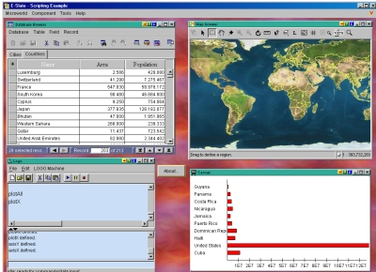
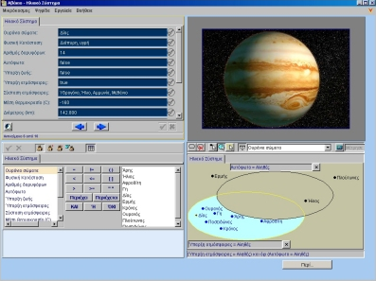
Microworlds
http://e-slate.cti.gr/Microworlds3.htm

Slide 38
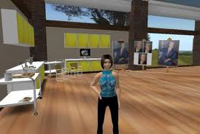
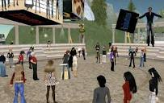
Virtual worlds
Virtual worlds are multiplayer (and often massively multiplayer) 3D persistent social environments

Slide 39
Example of Serious Games
http://youtu.be/c4sxxxQ4qTA
Can you identify subject areas and learning objectives?
http://www.scribd.com/doc/38131253/Games-in-Education-Serious-Games-A-Literature-Review

Slide 40
Examples of today’s applications
http://www.youtube.com/watch?v=0SnEy8Vp4V8&feature=relmfu
Can you identify subject areas and game technologies?
http://www.youtube.com/watch?v=NaE1YWzjx68

Slide 41
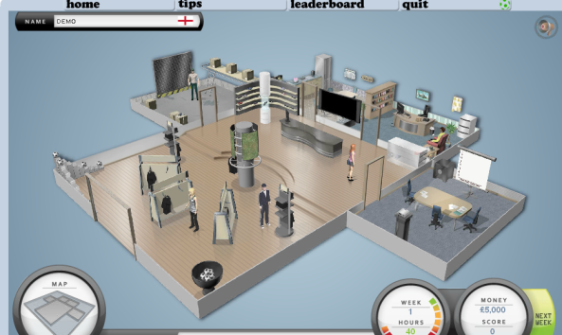
Examples
http://www.thesmallbusinessgame.co.uk/default.aspx

Slide 42
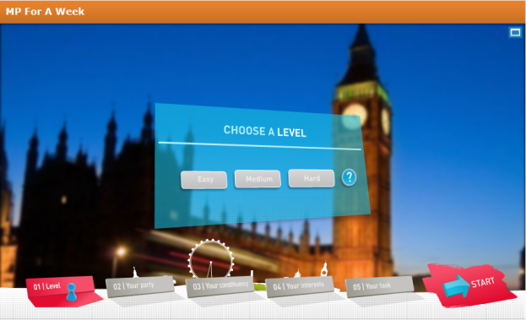
Politician for a Week
MP for a week: players experience the personal and professional dilemmas of a week in politics, taking responsibility for their decisions, and then seeing the implications on their careers.
http://www.parliament.uk/education/teaching-resources-lesson-plans/mp-for-a-week-game/

Slide 43
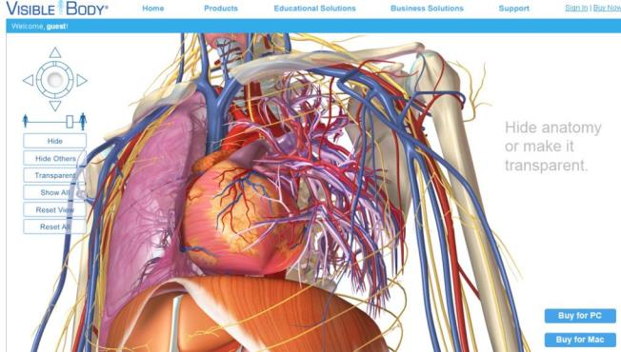
Examples
www.visiblebody.com

Slide 44
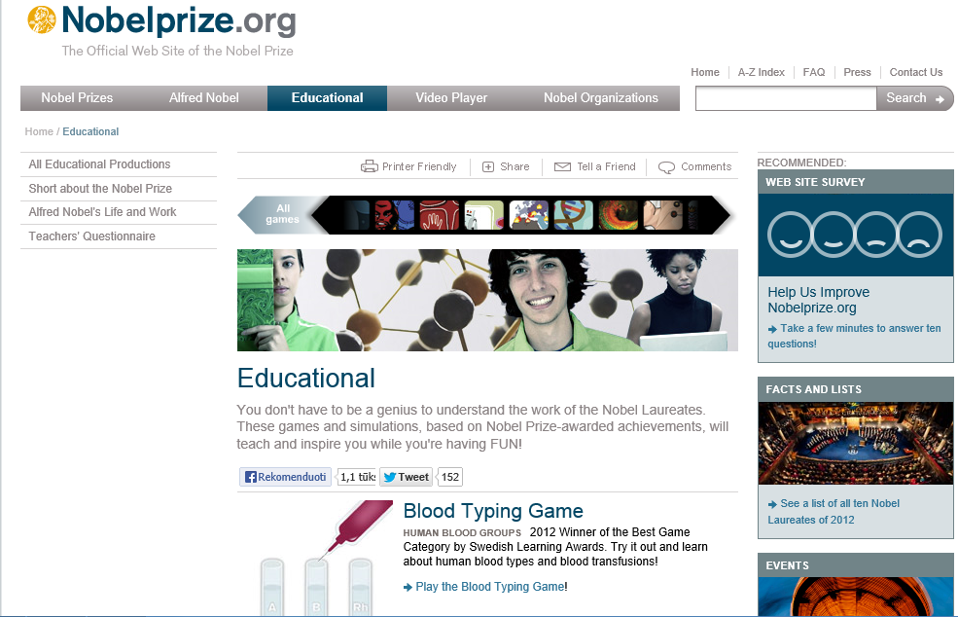
http://www.nobelprize.org/educational/

Slide 45
Digital manipulatives
http://nlvm.usu.edu/en/nav/vlibrary.html

Slide 46
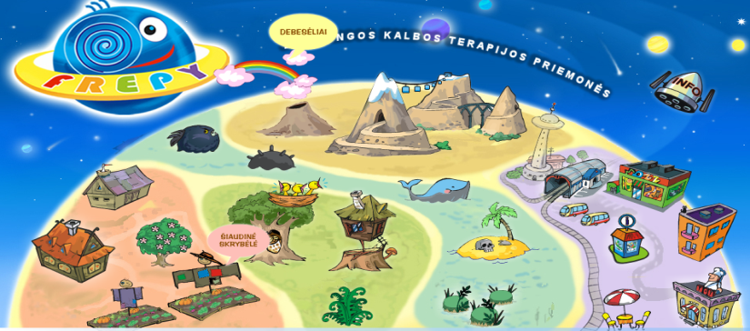
Friendly resourses for playful speech therapy
www.frepy.eu

Slide 47
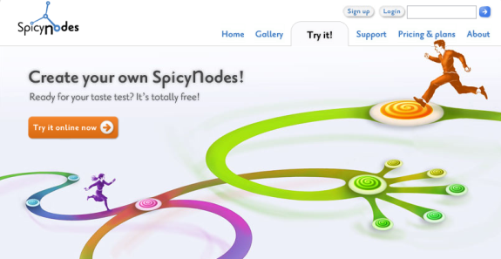
Mind maps
E-draw Mind Map,
Mind Manager,
Inspiration
Kids Inspiration
http://www.spicynodes.org/index.html
Etc..

Slide 48
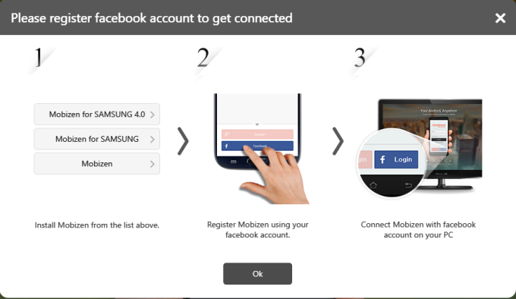
Mobizen - Connect to your Android anywhere
https://www.mobizen.com

Slide 49
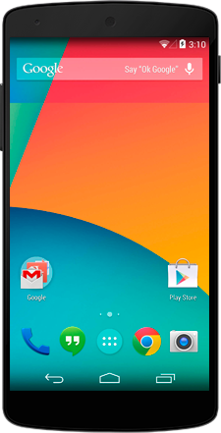
It's Easy to Get Started!
App Download
Register
Connect
1. Download Mobizen from The Google Play Store 2. Download and install Mobizen PC to your desktop 3. Connect to your Android Sign up for free in less than a minute!

